Slide 1
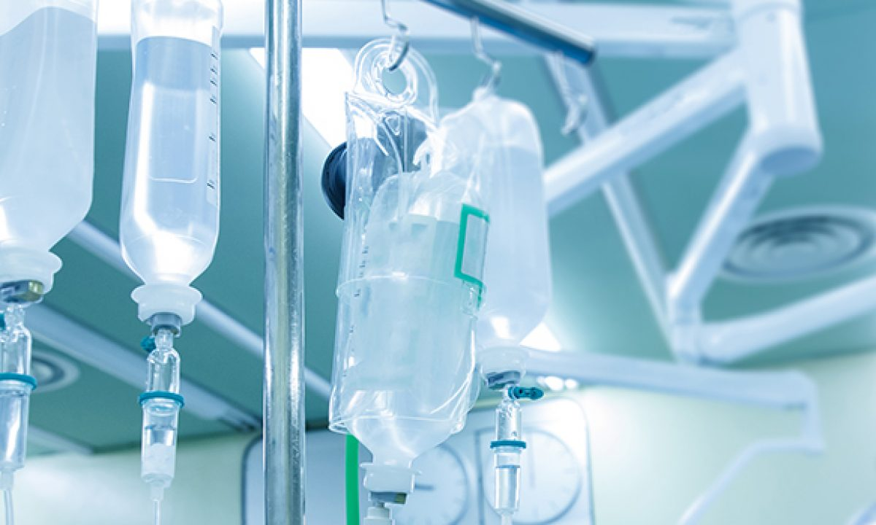
Fluid Therapy
Lec. Dr. Rafid M. Naeem,

Slide 2
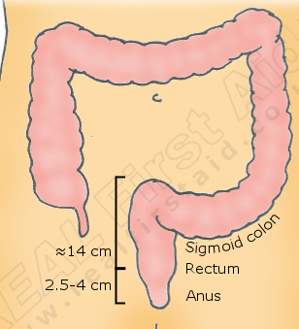
In the nineteenth century. Only severely ill patients received intravenous fluids and proctoclysis (rectal administration of fluid), while less critical patients were given subcutaneous and intraperitoneal fluid therapy
.
In both veterinary and human intravenous fluid therapy are remarkable

Slide 3
Perioperative patients often are not drinking or eating. The animal continues to make urine, saliva, and gastrointestinal secretions, and to lose fluid via respiratory evaporation.
غالبًا ما لا يشرب المرضى المحيطون بالجراحة أو يأكلون. يستمر الحيوان في إفراز البول واللعاب والإفرازات المعدية المعوية ويفقد السوائل عن طريق التبخر التنفسي.
During times of illness or following surgery, both increased fluid losses and decreased intake may lead to dehydration.
خلال أوقات المرض أو بعد الجراحة ، قد يؤدي كل من زيادة فقد السوائل وانخفاض تناول الطعام إلى الجفاف.

Slide 4
Dehydration, also known as hypohydration, is defined as loss of bodily fluids and can cause changes in all fluid departments, depending on the type of fluid lost.
Abnormal fluid losses commonly occur via urinary (e.g., polyuria) and gastrointestinal (e.g., diarrhea and vomiting) losses, although skin (e.g., burns) ec.

Slide 5
Isotonic replacement fluids should be administered according to
a. the patient’s estimated dehydration (replacement need),
b. maintenance needs, and
c. anticipated ongoing losses.

Slide 6
Physical examination findings in animals with evidence of dehydration can be found in this Table

Slide 7
in animals with 5% to 8% dehydration) use the following formula:
Ongoing losses include those caused by vomiting, diarrhea, polyuria, open wounds or burns, fever, third-spacing, or blood loss.

Slide 8
Maintenance fluid rates are estimated at 2 to 4 mL/kg/hr, with larger or overweight animals using the lower end of the range and smaller or thin patients the upper end. More exact requirements can be found in Tables

Slide 11
During anesthesia, most animals are given 5 to 10 mL/kg/ hr of isotonic crystalloids intravenously to maintain intravascular volume and pressures.\
Animals that have considerable ongoing losses and those that will not be able to drink within a short time require additional fluid therapy.
Continued intravenous fluid therapy is especially important in geriatric animals, those that have considerable postoperative fluid losses and patients that are not cardiovascularly stable.

Slide 12
FLUID TYPES AND USES
The common Fluid types available for use in the surgical patient include isotonic crystalloids, hypotonic crystalloids, hypertonic crystalloids
Crystalloid solutions contain electrolytes and other solutes
تحتوي المحاليل البلورية على إلكتروليتات ومواد مذابة أخرى
1. Isotonic crystalloids, also known as replacement fluids, are electrolyte-containing fluids with a composition similar to that of extracellular fluid.

Slide 13
1. Isotonic Crystalloids
Isotonic crystalloids are the type of fluid most commonly used for perioperative treatment.
البلورات متساوية التوتر هي نوع السائل الأكثر شيوعًا في العلاج قبل الجراحة
Infusion of isotonic crystalloid fluids does not significantly change the osmolarity of the vascular or extravascular (both interstitial and intracellular) space.
These fluids are typically used to expand the intravascular and interstitial spaces and to maintain hydration.

Slide 14
Isotonic crystalloids most commonly used contain mixtures of electrolytes, water, ±acid-base components, ±dextrose.
Most available isotonic crystalloids, other than 0.9% NaCl, contain a bicarbonate precursor such as lactate, acetate, or gluconate.
These fluids are “extracellular-expanding fluids,” and 75% of the volume infused redistributes to the interstitial space, while only 25% remains in the vascular space.
هذه السوائل عبارة عن "سوائل تنتشر خارج الخلية" ، ويتم إعادة توزيع 75٪ من الحجم الذي يتم ضخه في الفراغ الخلالي ، بينما يبقى 25٪ فقط في حيز الأوعية الدموية.
A typical shock dose is ≈1 blood volume (i.e., 90 mL/kg in the dog and 50 mL/kg in the cat).,.
جرعة الصدمة النموذجية هي 1 حجم دم (أي 90 مل / كجم في الكلب و 50 مل / كجم في القط

Slide 15
Excessive fluid administration should be avoided and can be harmful to the small animal surgical patient. Interstitial fluid gain can lead to interstitial edema, pulmonary edema, and cerebral edema.
Animals with recently lacerated or ruptured blood vessels are susceptible to rebleeding following aggressive fluid therapy. In those animals suffering blood loss, hypotension may contribute to cessation of bleeding.
الحيوانات التي لديها أوعية دموية تمزق أو تمزق مؤخرًا هي عرضة للنزيف من جديد بعد العلاج بالسوائل الكثيرة.
في الحيوانات التي تعاني من فقدان الدم ، قد يساهم انخفاض ضغط الدم في وقف النزيف

Slide 16
Surgical patients with a hypochloremic metabolic alkalosis will benefit from 0.9% NaCl because this is the highest chloride-containing fluid. It will help to normalize blood pH by dilution and by increased chloride, with a subsequent decrease in bicarbonate concentration.
سيساعد على تطبيع درجة الحموضة في الدم عن طريق التخفيف وزيادة الكلوريد ، مع انخفاض لاحق في تركيز البيكربونات.
Surgical animals that are severely acidotic may benefit from a crystalloid that contains a buffer agent such as acetate, gluconate, or lactate (i.e., NOT 0.9% NaCl because this fluid tends to be acidifying).
قد تستفيد الحيوانات الجراحية شديدة الحموضة من مادة بلورية تحتوي على عامل منظم مثل الأسيتات أو الغلوكونات أو اللاكتات (أي ليس 0.9٪ كلوريد الصوديوم لأن هذا السائل يميل إلى التحميض).
Large quantities of acetate can cause vasodilation and a decrease in blood pressure in animals with preexisting hypovolemia.
يمكن أن تسبب الكميات الكبيرة من الأسيتات توسع الأوعية وانخفاض ضغط الدم في الحيوانات التي تعاني من نقص حجم الدم الموجود مسبقًا.

Slide 17
2. Hypotonic Solutions
Maintenance fluids are hypotonic and refer to the volume of fluid and quantity of electrolytes that must be consumed on a daily basis to keep the volume of total body water and electrolyte content within the normal range.
سوائل الادامة ناقصة التوتر وتشير إلى حجم السوائل وكمية الإلكتروليتات التي يجب استهلاكها بشكل يومي للحفاظ على الحجم الكلي لمياه الجسم ومحتوى الإلكتروليت ضمن النطاق الطبيعي.
They are especially useful in perioperative patients that are not eating or drinking but are otherwise stable and do not have ongoing fluid losses beyond those of a normal animal.
Maintenance solutions include 0.45% sodium chloride, 2.5% dextrose with 0.45% saline, 2.5% dextrose with half-strength lactated Ringer’s solution
Large volumes of hypotonic maintenance fluid administration can lead to a rapid decrease in osmolarity and subsequent cerebral edema.

Slide 18
3. Hypertonic Solutions
Hypertonic (7.0% to 7.5%) sodium chloride administration causes a transient osmotic shift of water from the extravascular to the intravascular compartment. Small volumes of ≈4 to 6 mL/kg can be administered over 10 to 20 minutes.
يؤدي تناول كلوريد الصوديوم مفرط التوتر (7.0٪ إلى 7.5٪) إلى تحول تناضحي عابر للماء من خارج الأوعية الدموية إلى الحيز داخل الأوعية. يمكن إعطاء كميات صغيرة من 4 إلى 6 مل / كجم خلال 10 إلى 20 دقيقة.
Hypertonic saline is especially useful for the treatment of head trauma or cardiovascular shock in animals >30 kg that require large amounts of fluid for resuscitation e.g., patients with gastric dilatation-volvulus.

Slide 19
Because of the osmotic diuresis and rapid redistribution of sodium cations that ensue following administration of hypertonic saline, the intravascular volume expansion is transient (<30 minutes) therefore additional fluid therapy must be used to maintain intravascular volume and prevent dehydration.
بسبب إدرار البول التناضحي وإعادة التوزيع السريع لكاتيونات الصوديوم التي تنتج بعد إعطاء المحلول الملحي مفرط التوتر ، يكون توسع الحجم داخل الأوعية عابرًا (أقل من 30 دقيقة) ، ويجب استخدام علاج سوائل إضافي للحفاظ على الحجم داخل الأوعية ومنع الجفاف
25% mannitol could also be used as a hypertonic fluid.

